Slide 1

Progress Report
Team FHIR Ball
Ghaieth Zouaghi; Davor Sabljic; Zachary Bienenfeld

Slide 2
Project Description (Reminder)
Smartphone app (Android) that helps improve medication adherence at the community level.
The app will capture information regarding whether or not the patient took the medication. If not, the patient will enter a reason. The information is then able to be shared with a healthcare provider.

Slide 3
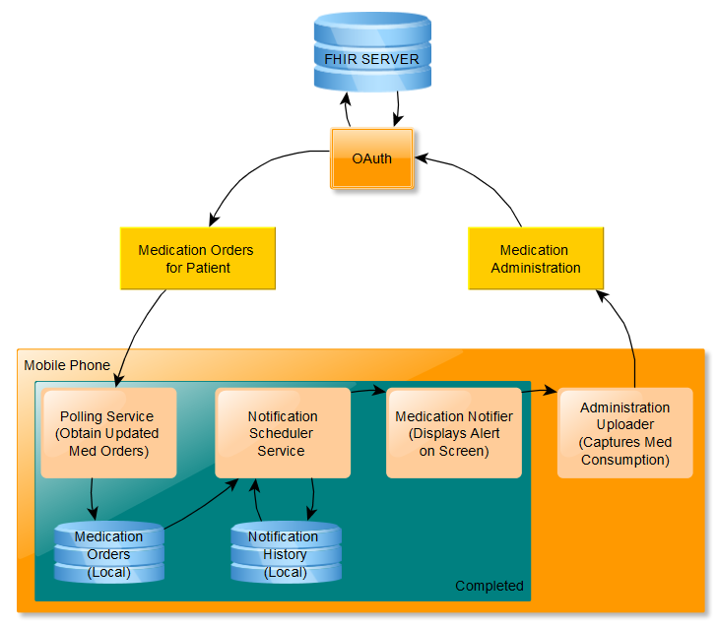
Architectural
Diagram
(Completed section shown in blue background)
Notes:
This is the architecture diagram of the app. There are two data flows that take place; 1. pulling data from FHIR and 2. Pushing data to FHIR. Both of these communications with FHIR require some type of authentication such as OAuth.
In the first flow, the app periodically queries the FHIR server for the medication orders that are listed for the app user. It then stores that data in a local android database.
The second flow uploads the medication administration to the FHIR server. This flow begins by the notification scheduler sending a notification to the app user’s screen telling them that a medication is due. This information is obtained from the local copy of the medication orders described in the first flow. The app then captures whether or not the medication was taken via input from the user and sends that data to FHIR.

Slide 4
Project Status
What is done
Android App is in progress with the following components complete:
Initial screen shows two buttons: My Medications and My Schedule
Periodically refreshes to gather updated Medication Order information.
Stores that information in a local database.
That local database is queried when users access the Medications page.
A Notification appears on the phone when it is time to take a medication:
Reads the local “medications orders” table and showing a notification if the time has elapsed since it was taken last (reads from “notification history” table)
In Progress
Syncing Medications from FHIR instance to get fresh list of medications. (currently mocked)

Slide 5
Project Status continued...
What still needs to be done
Get response from user regarding whether took the medication, and:
Update the “notification history” table
Upload that information to FHIR server
Display data in the “My Schedule” from the “notification history” table.
Come up with and conduct testing plan.
Figure out deployment strategy.
Blockers
We have faced significant difficulty getting a local FHIR instance started.
We are awaiting a response on our private piazza page: https://piazza.com/class/irxx3yccn17ii?cid=434

Slide 6
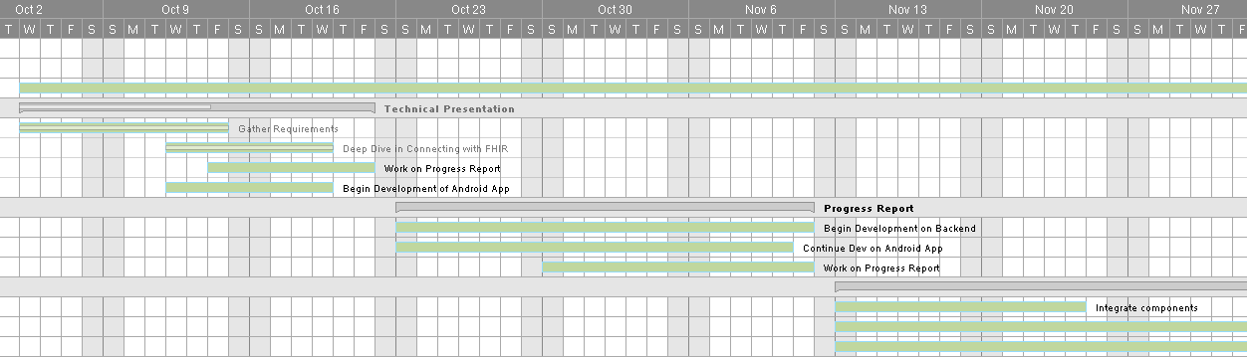
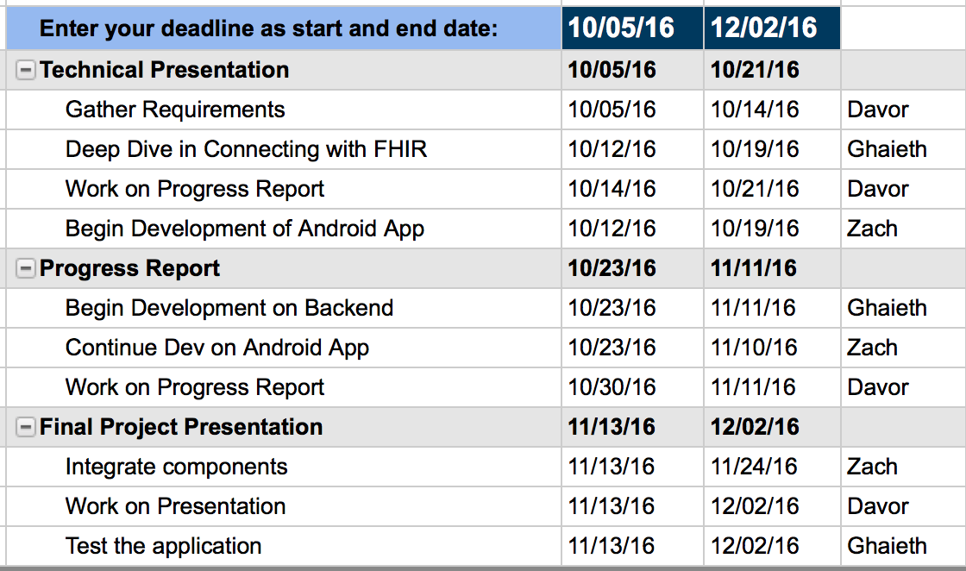
Gantt Chart
Gantt Chart

Slide 7
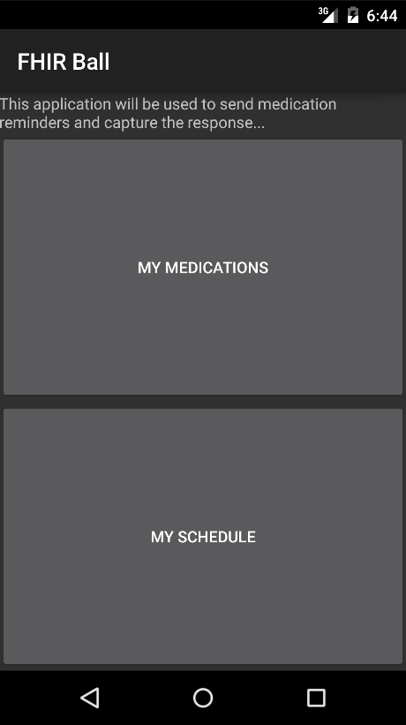
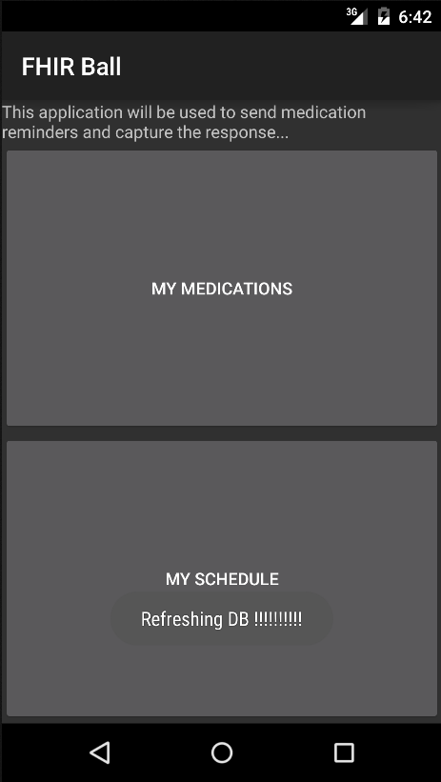
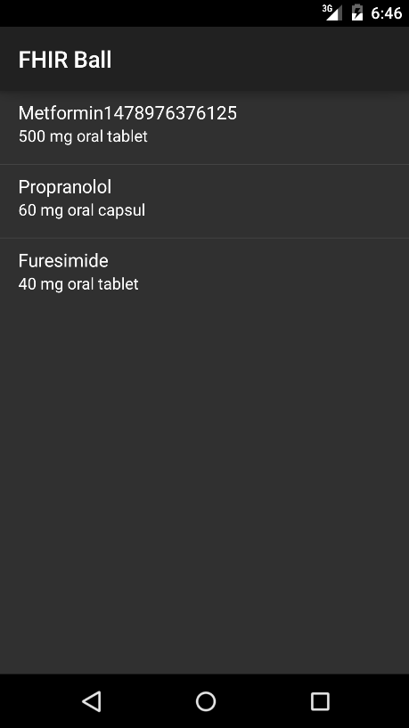
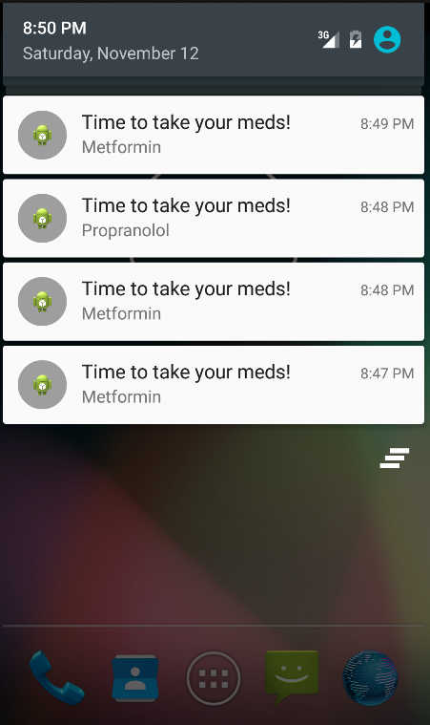
Screenshots
Refresh Occurring on Cadence
Home screen
My Medications
Notifications Received

